Slide 1

Glitzifyy – E-Commerce Web Application with Java Integration
A Full-Stack Shopping Cart with Dynamic Invoice Generation
Presented by: Raghul RB.E. CSE – AI & RoboticsSathyabama Institute of Science and Technology

Slide 2
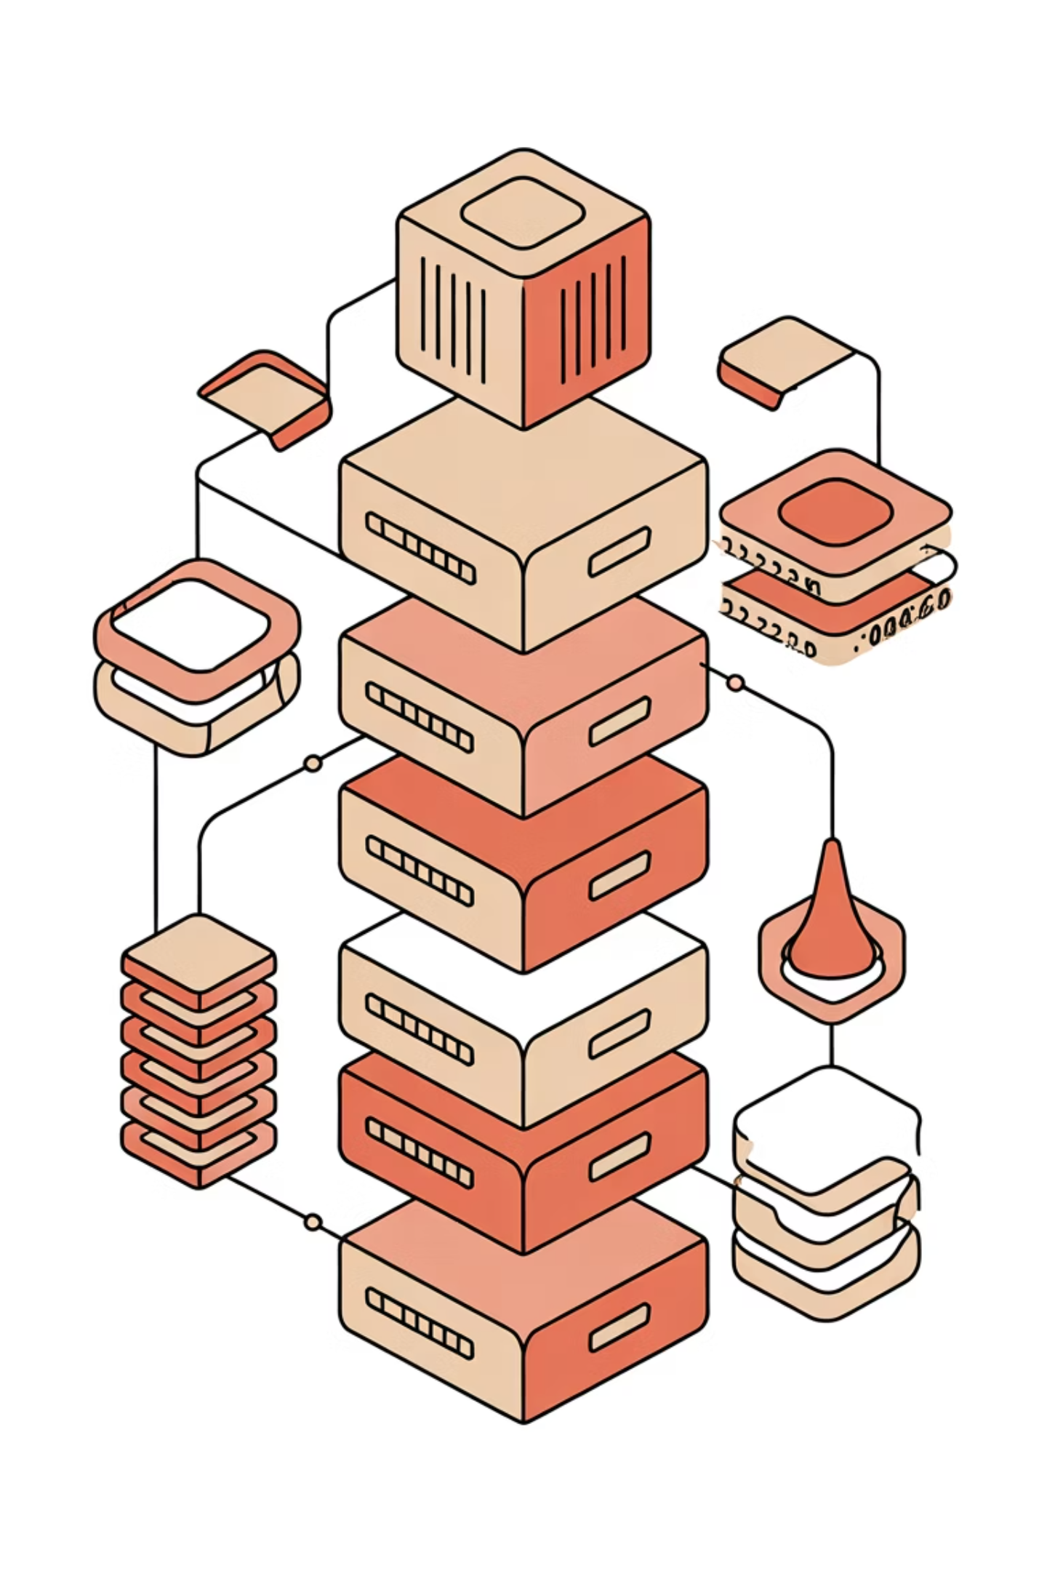
Project Overview
Objective
Key Features
To build a premium, responsive e-commerce website with dynamic cart functionality and backend simulation using Java, demonstrating full-stack development capabilities.
Product listing from JSON data
Dynamic cart with real-time calculation
RESTful API using Node.js
Java-based invoice generator

Slide 3




Frontend Technologies
Core Technologies
Responsive Design
HTML5, CSS3, and JavaScript form the foundation of our responsive interface
Grid layout system ensures seamless viewing across all devices
Dynamic Rendering
File Generation
DOM manipulation provides real-time cart updates and interactivity
Blob API enables downloadable invoice functionality
The frontend delivers a clean, intuitive user experience with real-time cart updates and instant invoice downloads in .txt format.

Slide 4

Backend Architecture
Backend Stack
API Endpoints
Node.js with Express framework powers our RESTful API, providing robust server-side functionality and efficient request handling.
GET /api/cart – Retrieves current cart contentsDELETE /api/cart – Clears cart items
Data Management
Product catalogue stored in products.json with in-memory cart simulation for fast performance and easy testing.

Slide 5

Java Integration – Invoice Generator
Why Java?
Demonstrates backend logic capabilities
Complements web-based cart system
Essential for academic evaluation
Shows multi-language integration skills
Program Highlights
The Java programme accepts product details, quantity, and price, calculates the total amount, and prints a professionally formatted invoice directly to the console.

Slide 6
Enhanced Feature – Downloadable Invoice
01
02
Download Button
Data Retrieval
User-friendly interface with prominent "Download Invoice" button
Fetches complete cart data from backend API
03
04
Invoice Generation
File Download
Creates formatted .txt file with product details and subtotals
Delivers invoice using JavaScript Blob API with dynamic file generation
The invoice includes comprehensive product details, individual subtotals, final total calculation, and a professional thank-you message for enhanced customer experience.

Slide 7
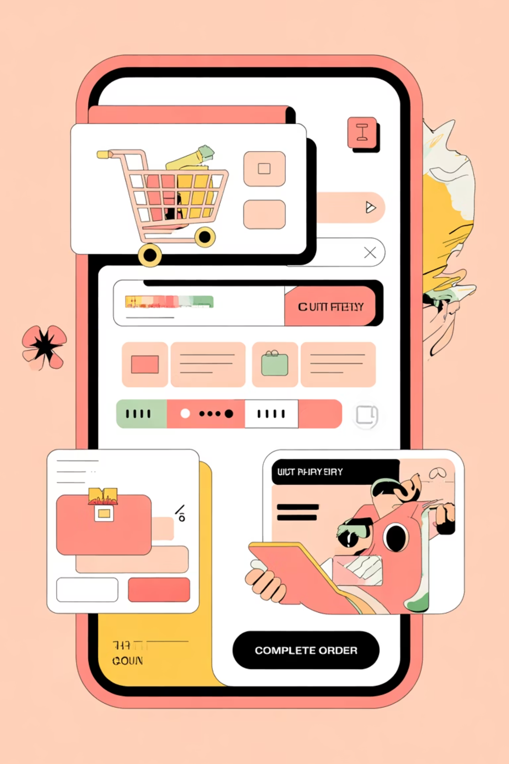




Demo Flow
Add Products
Browse catalogue and add items to cart
View Summary
Review cart with real-time totals
Download Invoice
Click to generate invoice file
Complete Purchase
Receive Glitzifyy_Invoice.txt
Bonus: Run InvoiceGenerator.java from terminal to simulate backend invoice generation logic independently.

Slide 8
Project Structure
Folder Organisation
Architecture Benefits
Clear separation of concerns
/glitzifyy-project├── index.html├── shop.html├── cart.html├── style.css├── /java-demo│ └── InvoiceGenerator.java
Easy to navigate and maintain
Modular component structure
Scalable for future features
The organised structure ensures easy collaboration, maintainability, and professional code management throughout development.

Slide 9
Key Advantages
Modular Design
Real-Time Logic
Java Integration
Premium UX
Clear frontend and backend separation for maintainability
Instant cart updates and calculations
Backend simulation demonstrates versatility
Clean UI with downloadable invoice feature
The application is viva-friendly, scalable, and demonstrates comprehensive full-stack development skills with multi-language integration.

Slide 10
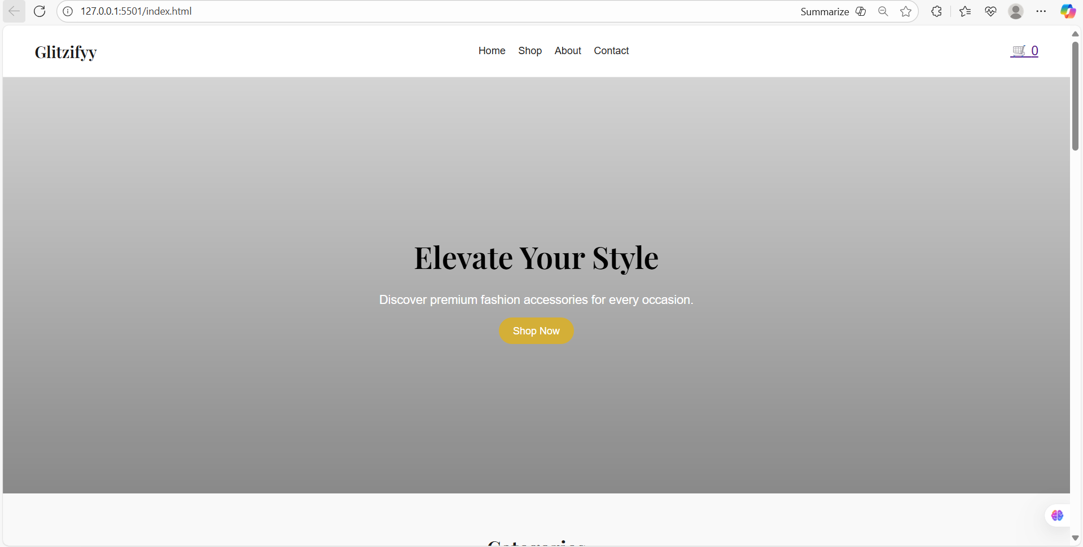

Slide 11
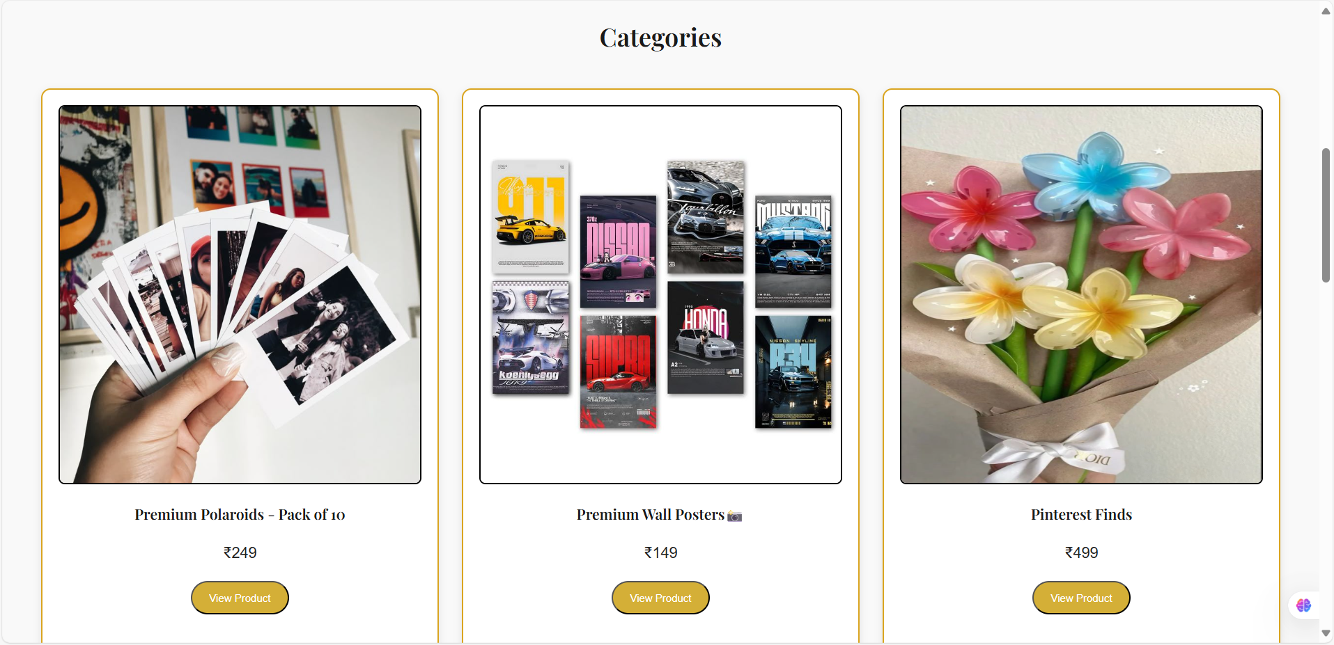
EXAMPLES

Slide 12
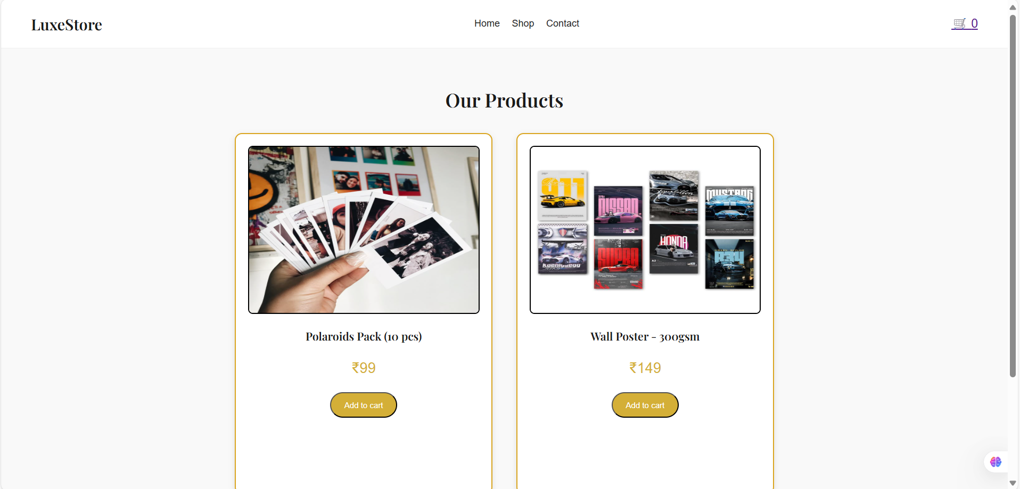
EXAMPLES

Slide 13
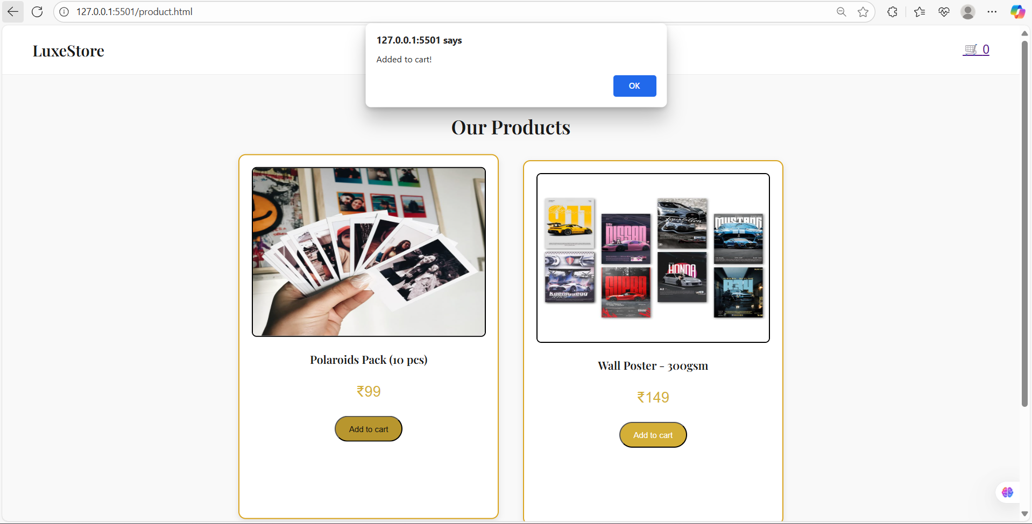
Users can browse items, view pricing, and add products to their cart with a single click.
A confirmation popup ensures smooth interaction and enhances the shopping experience.

Slide 14
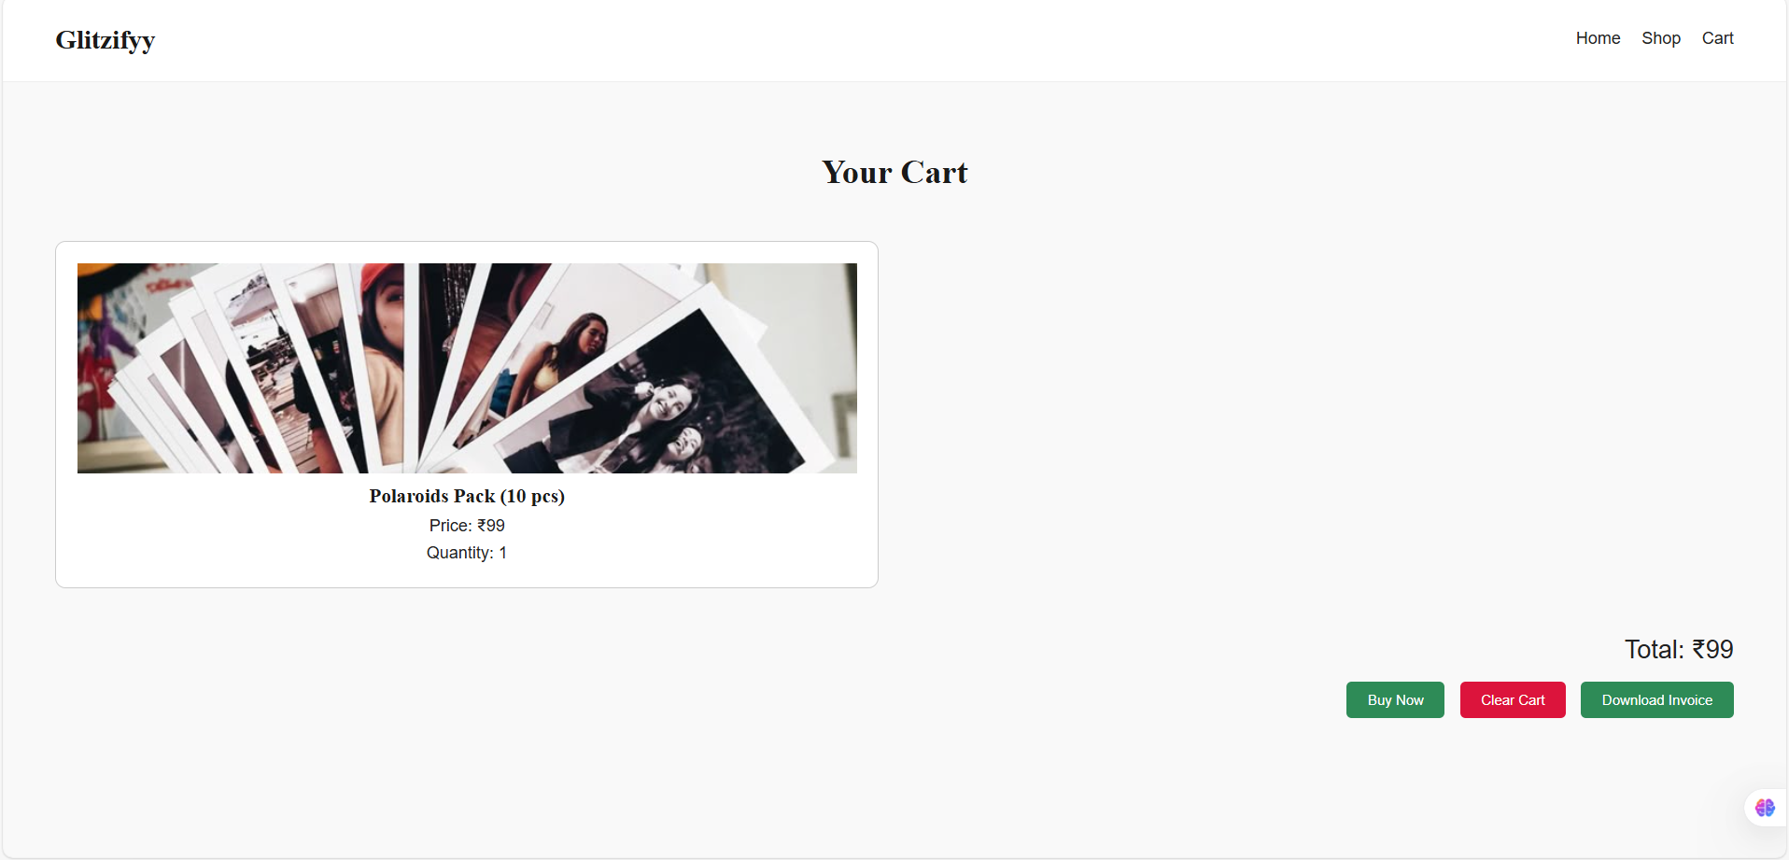
This slide displays the cart interface of Glitzifyy. Users can review selected items, see real-time pricing, and proceed to checkout. Functional buttons allow them to confirm purchase, clear the cart, or download a detailed invoice — enhancing both usability and backend simulation.

Slide 15
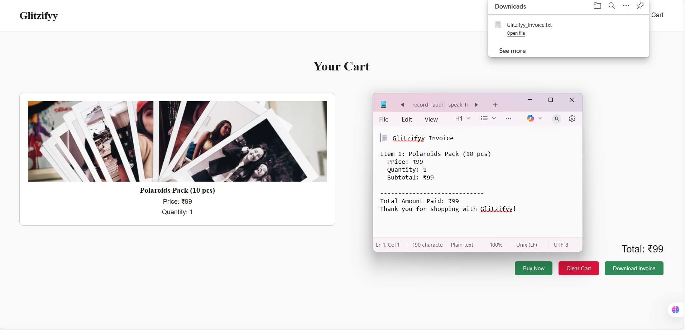
This slide demonstrates the invoice generation feature of Glitzifyy.
After confirming a purchase, users can download a invoice containing product details, quantities, subtotals, and the final amount paid. This enhances transparency and simulates backend billing logic — all handled dynamically through JavaScript.

Slide 16

Conclusion
Full-Stack Integration
Successfully connected frontend and backend components with seamless data flow
REST API Design
Implemented professional API architecture following industry best practices
JavaScript File Handling
Mastered Blob API for dynamic file generation and downloads
Java Backend Simulation
Demonstrated multi-language capabilities and backend logic implementation
This project showcases a comprehensive understanding of modern web development, combining frontend interactivity with backend processing to create a professional e-commerce solution.

